Slide 1
Data Driven Bots

Slide 2
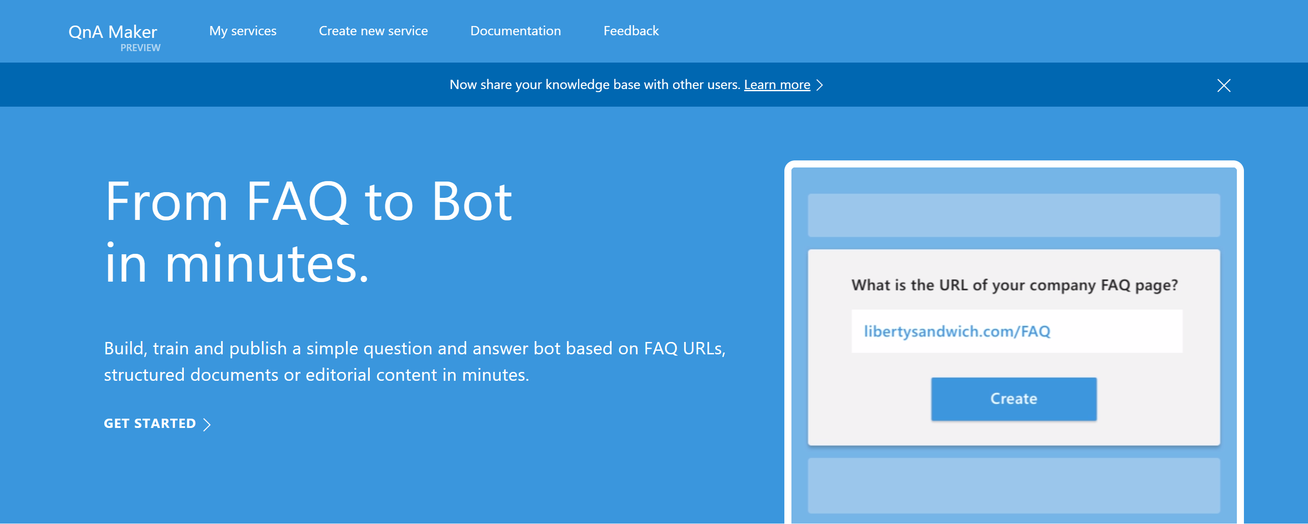
Knowledge Base Bots and QnA Maker
#MSBuild

Slide 3
QnA Maker

Slide 4
AdventureWorks
ProductID | Name | ListPrice
921 | Mountain Tire Tube | $4.99
922 | Road Tire Tube | $3.99
923 | Touring Tire Tube | $2.00

Slide 5


Commands
Intent:
order
LUIS
Intent: order
Item: mountain tire tube
I'd like to order a mountain tire tube

Slide 6
Contoso Travel
Location | Getting There | Categories | Description
Alaska | Fly, Road Trip, Cruise | Nature | Famous for its wildlife, Alaska is popular with adventure seekers.
California | Fly, Road Trip | Nature, City, Beach | California offers a diverse set of experiences.
Hawaii | Fly, Cruise | Nature, Beach | A perfect getaway for those looking to relax.

Slide 7
Queries
NLP
I'd like to take a vacation
I'd like to take a vacation!
I'd like to take a road trip to a nature destination!

Slide 8
Why not just use LUIS?
LUIS does…
Intent
What is the user trying to do?
Entity values
What additional context is the user providing?
LUIS doesn't…
Validate data
Help drive the user
LUIS is not a search engine

Slide 9
Azure Search
Bing/Google style search internal in your application
Respond to user questions from an answer bank
Interactive refinement
Guide search through drilldowns
Fuzzy lookups
"Did you mean...?"
Affect the results
Move items up and down

Slide 10
Controlling results
Azure search doesn't know everything
Most popular items in a product catalog
The importance of new items
Abbreviations or nicknames
Weights
Mark certain columns as more important
Functions
Control results based on numeric values, tags and freshness

Slide 11
Azure Search
I'd like to take a vacation!
Azure Search

Slide 12
Contoso Travel
Location | Getting There | Categories | Description
Alaska | Fly, Road Trip, Cruise | Nature | Famous for its wildlife, Alaska is popular with adventure seekers.
California | Fly, Road Trip | Nature, City, Beach | California offers a diverse set of experiences.
Hawaii | Fly, Cruise | Nature, Beach | A perfect getaway for those looking to relax.

Slide 13
Azure Search
Azure Search
Categories:
[Nature, City, Beach]
I'm looking for nature destinations.

Slide 14
AdventureWorks
ProductID | Name | ListPrice
921 | Mountain Tire Tube | $4.99
922 | Road Tire Tube | $3.99
923 | Touring Tire Tube | $2.00

Slide 15
Azure Search and LUIS
Intent:
order
LUIS
Intent: order
Item: mountain tube
Search: mountain tube
I'd like to order a mountain tube
Azure Search

Slide 16
AdventureWorks
ProductID | Name | ListPrice
921 | Mountain Tire Tube | $4.99
922 | Road Tire Tube | $3.99
923 | Touring Tire Tube | $2.00

Slide 17
Azure Search and LUIS
Intent:
order
LUIS
Azure Search
ID: 922
Name: Mountain Tire Tube
Search: mountain tube

Slide 18
Capabilities for Rich Search Experiences
All search building blocks needed for great experiences
Keyword search, faceting, suggestions/auto-complete, highlighting and more
Geospatial support for filtering, sorting and ranking
Flexible data ingestion options
Push: bring data from anywhere, on-prem or cloud, any store
Pull: built-in support for DocumentDB, SQL DB, Blob Storage, Table Storage
Document cracking support (PDF, Office, JSON, HTML, etc.)
Global presence, elastic capacity
Adjust capacity dynamically and workload demand changes
Available in 14 regions world wide

Slide 19
“Search service”
Scope for capacity
Bound to a region
Has keys, indexes, indexers, data sources
Manage search traffic analytics options
Provisioning
Azure Portal
Azure resource management API
Elastic scale
Capacity can be changed dynamically
Replicas ~ more QPS, HA
Partitions ~ more documents, write throughput
Provision service
Create index
Index data
Search

Slide 20
“Index”
Container for data, think “table”
Has schema, CORS options, search options
Create in portal or during app initialization
Typical schema
Fields definition: name, type, key
Search specifics
Field attributes – searchable, facetable, etc.
Linguistics and analysis
Suggesters for auto-complete
Scoring profiles for ranking tuning
Provision service
Create index
Index data
Search

Slide 21
Push - using indexing API
POST to /indexes/<name>/docs/index
Up to 1000 actions per batch
Actions can be upload, merge, delete, etc.
Pull - using indexers
Azure SQL DB, DocumentDB, Blob Storage
Change detection, deletion markers
Document cracking for blobs (PDF, Office, etc.)
Point it at the data source, define policy, done
Provision service
Create index
Index data
Search

Slide 22
Search + typical data operations
Simple search options, + - * () “”
Choose between simple search syntax and full Lucene query language
Filter, sort, project, page over results
Options work with search and suggest
Search from client or server
Use query keys when searching from clients
CORS allows direct calls from browsers
Render from search results
Include necessary non-searchable data
E.g. URLs for pictures, keys to main content
Provision service
Create index
Index data
Search

Slide 23
Geospatial
Full geospatial support built-in
Store
Geography point instances as GeoJSON
Query
Filter by distance and bounding box
Sort by distance
Ranking
Boost items based on distance

Slide 24
Custom relevance
Scoring profiles
Field weights
Scoring functions
magnitude, freshness, distance, tags
3 main patterns
Known data directly available in the index
Personalization using tag boosting
Analytics, compute externally and push to the index

Slide 25
Search Traffic Analytics
Search exhaust is invaluable
Search box: users tell you what’s in their mind
Most popular terms, top searches with no results, seasonality of products and more
Search logs exposed in blob storage
PowerBI: easy to get started, great for small/medium traffic
HDInsight: large scale traffic analysis
Bring your own tools, raw data available to you

Slide 26
Importing data into Azure Search

Slide 27
Accessing Azure Search
Azure Search is an OData endpoint
JSON result
Configure search
top
skip
search
Cross-origin resource sharing (CORS) concerns
Must be enabled to allow client (the bot) access

Slide 28
Query types
Search
Fuzzy Lookups
Filter
WHERE Name = 'Value'
Facets
Returns facets (or categories)

Slide 29
Querying Azure Search and improving results

Slide 30
Your turn
Update your bot to:
Allow the user to search through articles
Provide navigation mechanism by category

